Slide 1
High Waters for Low Riders:
Agent Modeling of Flooding in Espanola, New Mexico
Espanola Valley High School: Team 1
Chelsea Sisneros
Dafne Rodriguez
Jeremy Vigil
Angel Zavala

Slide 2
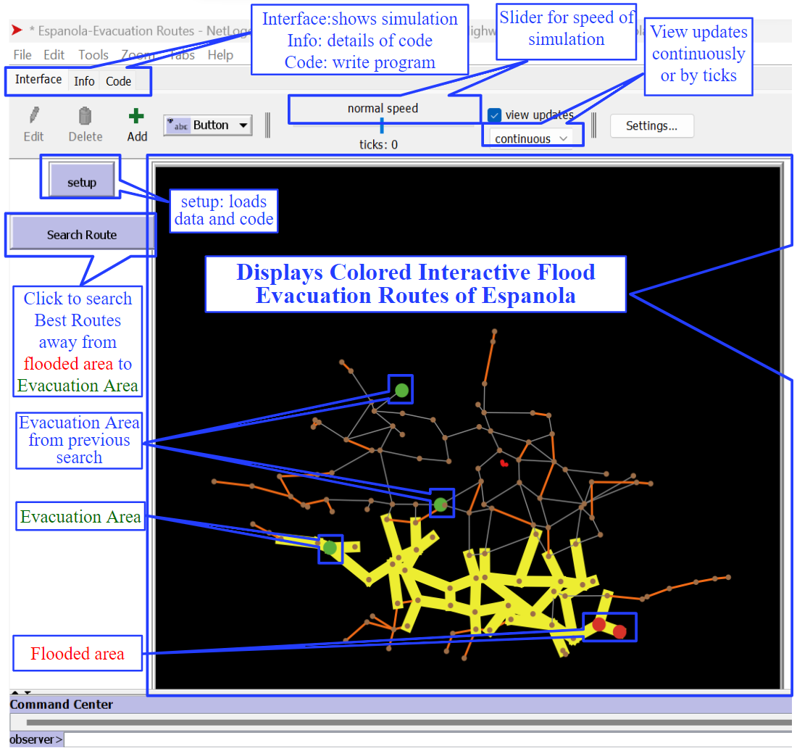
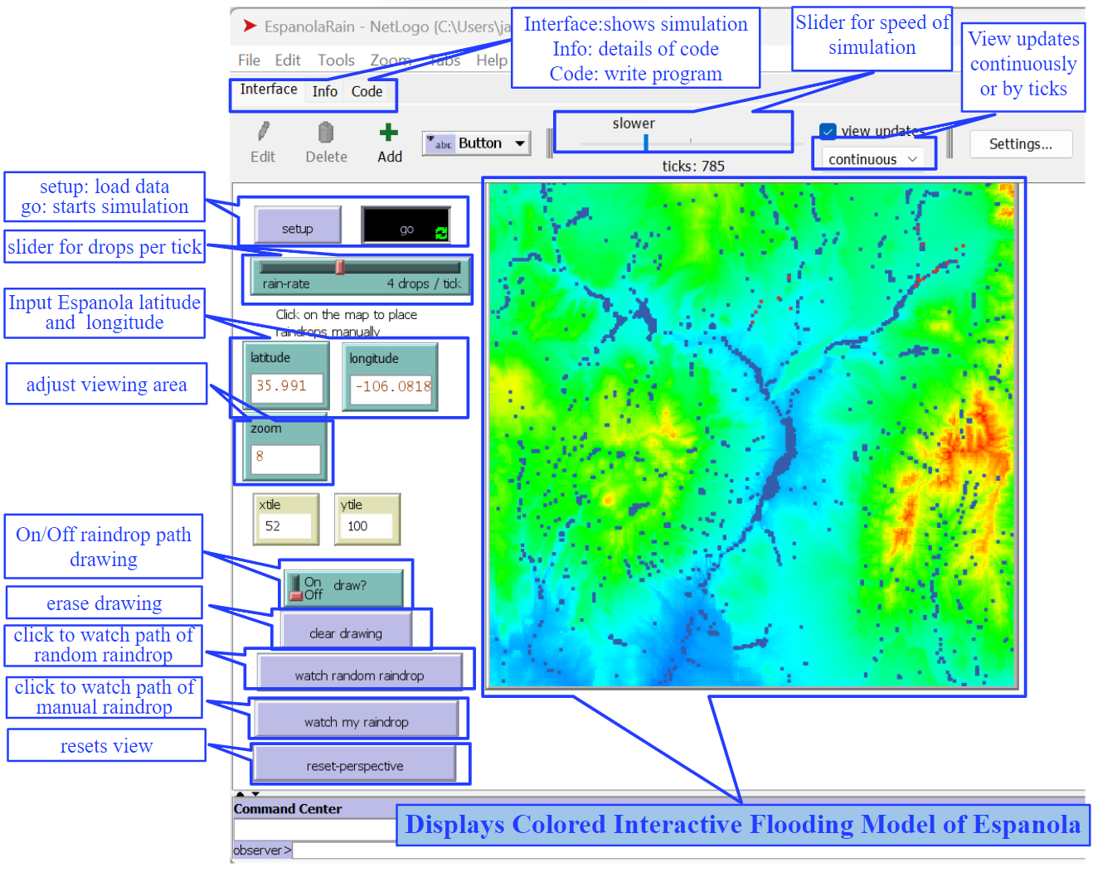
The users of of our project are the citizens of Espanola.
This allows citizens to stay safe and be aware of flooding and shows how climate is affecting our community (U.N. Goals 11 and 13).
Using this information, our community to come together and think of more ways to improve our environment as well (U.N. Goal 15).
This prototype demonstrates safe evacuation routes the citizens can take when flooding occurs using NetLogo and to the right is a landscape of espanola where flooding is more susceptible.

Slide 3
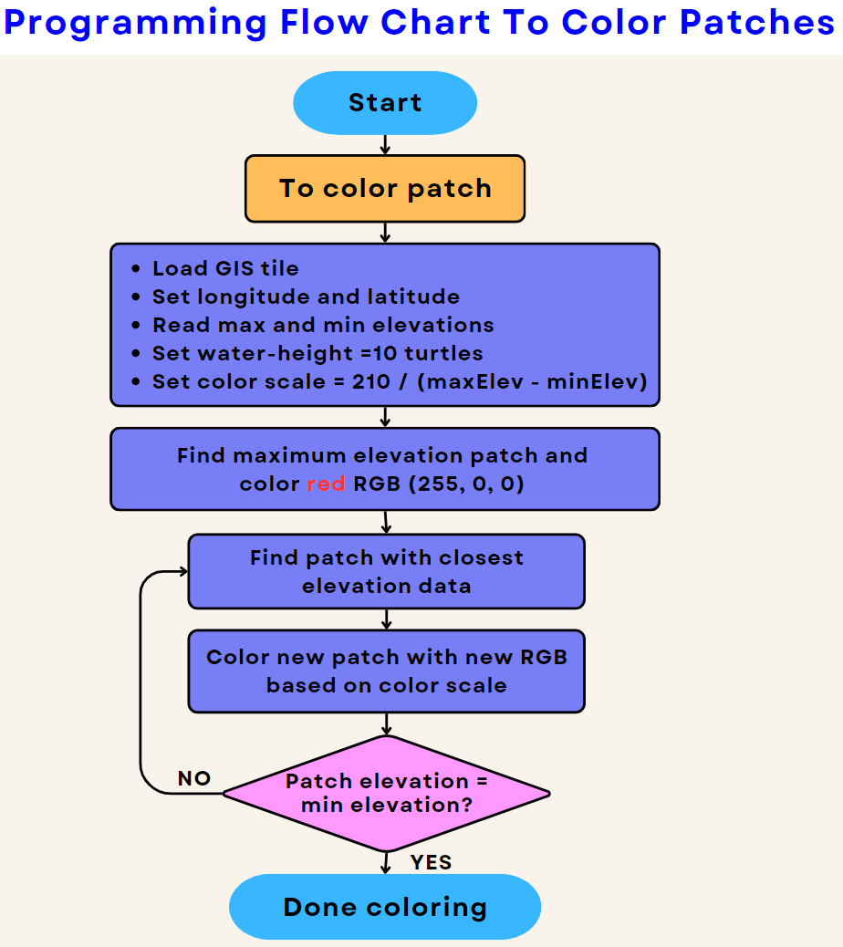
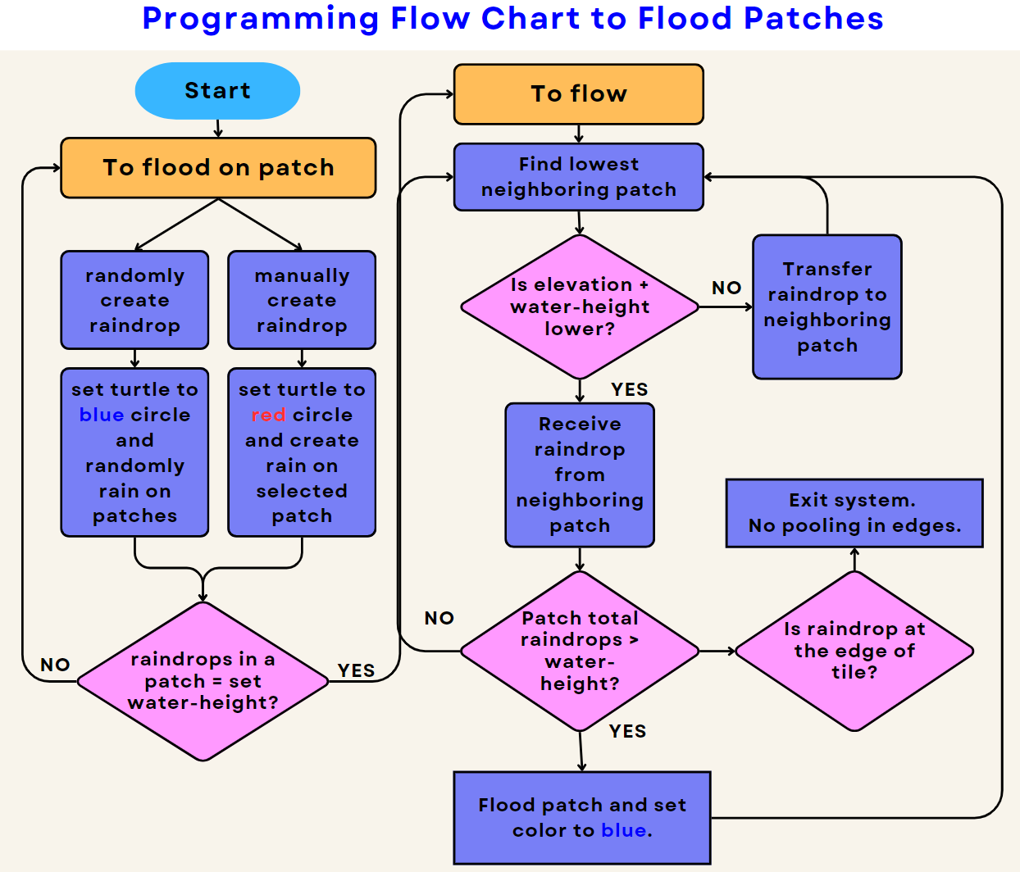
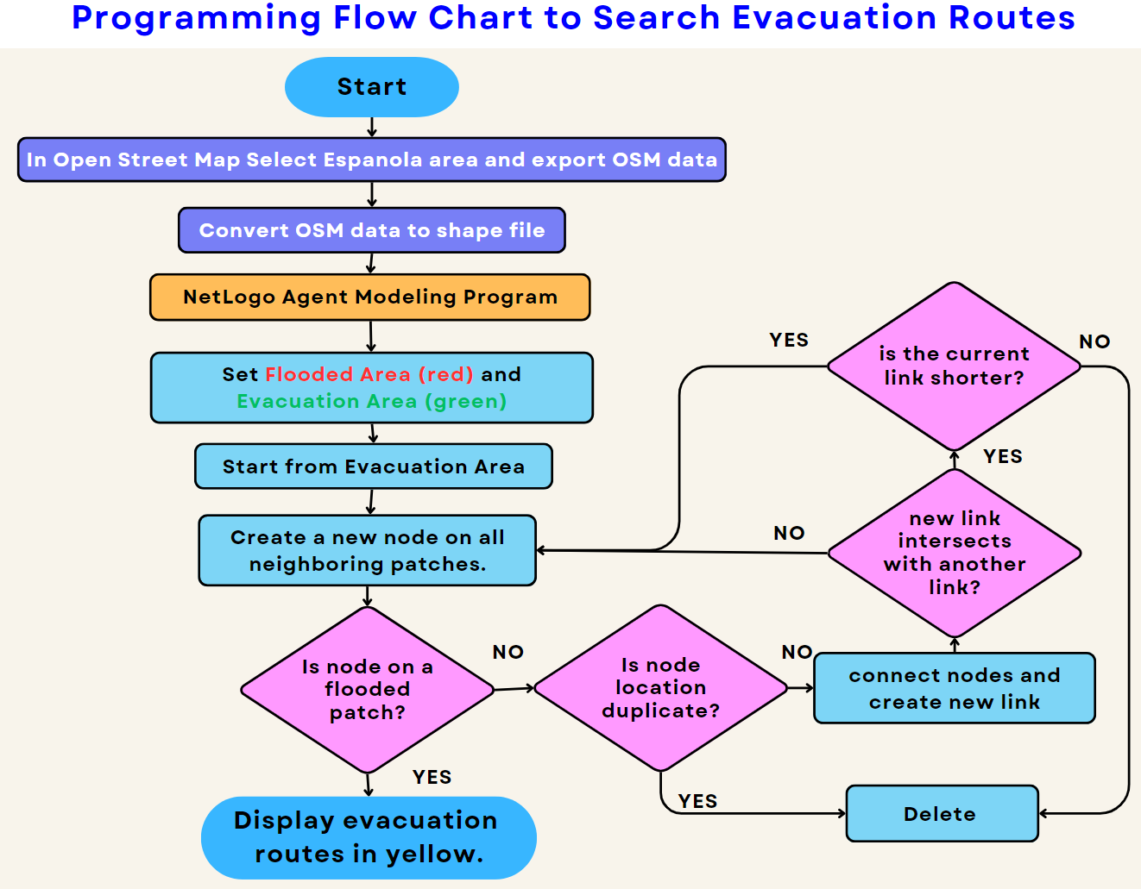
Demonstrations of how NetLogo’s coding works.

Slide 4
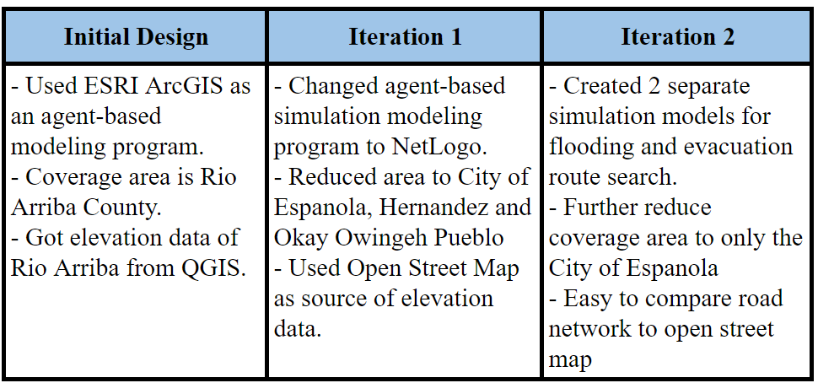
Design Process
Identify Problem
Citizens living in Espanola are in danger because Espanola is susceptible to flooding due to low infrastructure and poor economy.
Research
We discussed whether flooding or fire affected Espanola more. Flooding has affected 99% of
properties in Espanola.
Develop Solution
We created a prototype using Netlogo that displays Espanolas elevation and how water affects our area.
Design Iterations
Refine and Improvise
- Further reduce coverage area to only the City of Espanola
- Easy to compare road network to open street map
Simulation and User Feedback
Tested NetLogo
Works effectively
Shows Weak spots in Espanola

Slide 5
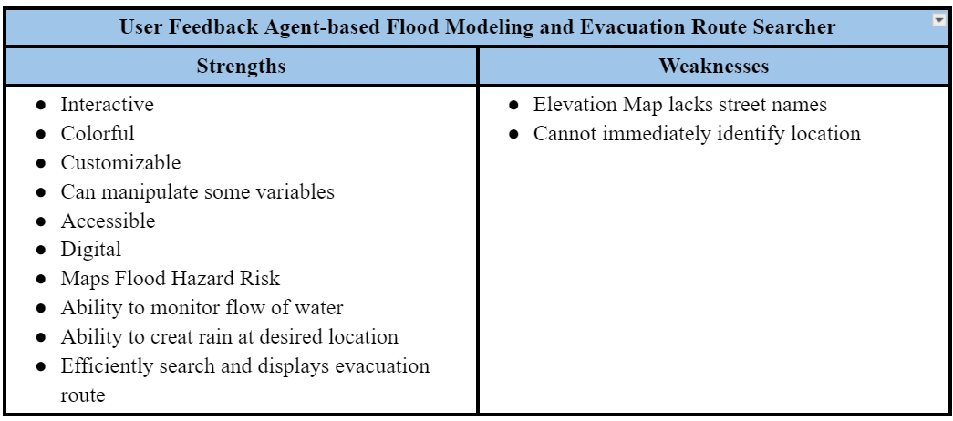
Conclusions:
The interactive agent-based models of Espanola Flooding and Evacuation Route Searcher are cutting edge technology tools that is free for both the local government and members of the community so everyone is informed and hopefully everybody will work collaboratively take action and work collaboratively so our city will be more resilient against any any water-related disasters.
Future Plans:
In the Evacuation Route Search Model add:
manual selection of evacuation area
street name layer
on-foot evacuation routes
In the Flood Model add more layer and label of map
Create 3D Simulation
Create simulation for other hazards
Present to the City Government of Espanola

